Slide 1
CAPTIONISTA
We speak the language of images
2 - February -2022

Slide 2
Building Model
Model Architecture can be divided into four parts:
Pretrained Model to extract image features.(Encoder 1)
Embedding and LSTM Layer to encode captions (Encoder 2)
Add Layer to merge the output of both encoders
Fully connected NN with SoftMax activation (Decoder)

Slide 3
Model Architecture (High Level)
Encoder-1
Image
VGG-16
DENSE
DENSE
ADD
Caption
LSTM
Encoder-2
Decoder

Slide 4
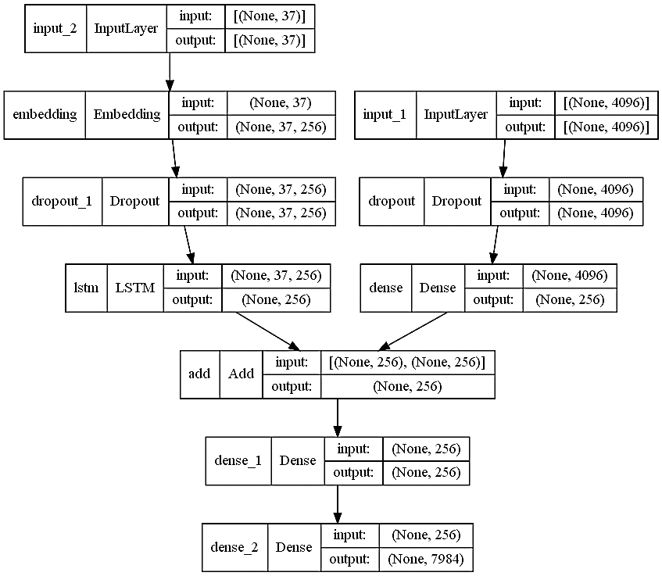
Model Architecture (Low Level)

Slide 5
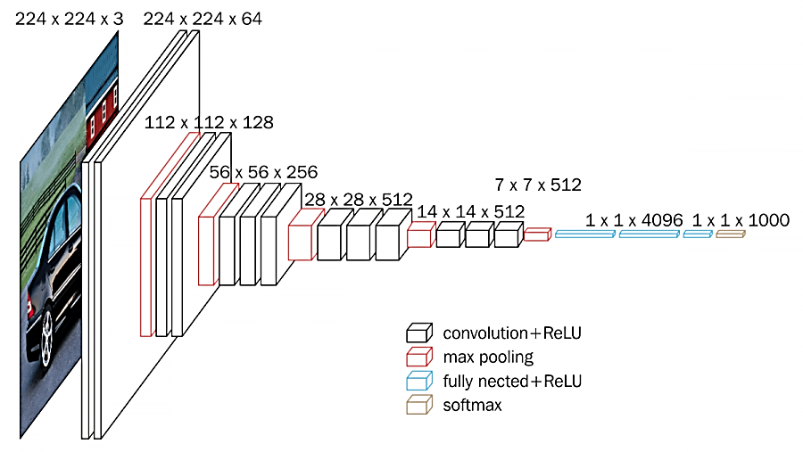
Pretrained Model to extract image features (Encoder 1)
DENSE
(NONE, 256)

Slide 6
Embedding and LSTM Layer to encode captions (Encoder 2)
(NONE, 256)
Pretrained Model
0
Pretrained Model
0
X0
X1
X2
X37

Slide 7
Fully connected NN with SoftMax activation (Decoder)
Image Encodings
(NONE, 256)
DENSE
DENSE
ADD
(NONE, vocab_size)
Caption Encodings
(NONE, 256)
(NONE, 256)

